Slide 1
Elements of Art

Slide 2
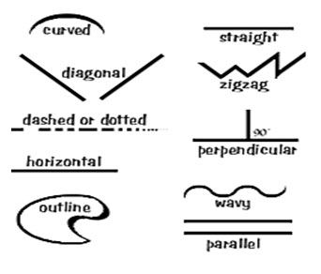
Line
Line is a mark with greater length than width. Lines can be horizontal, vertical,
or diagonal; straight or curved; thick or thin.

Slide 3
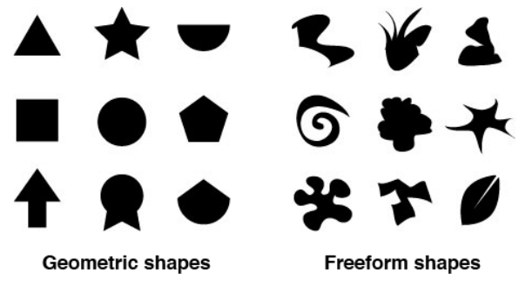
Shape
Shape is a closed line. Shapes can be geometric, like squares and circles; or
organic, like free-form or natural shapes. Shapes are flat and can express length
and width.

Slide 4
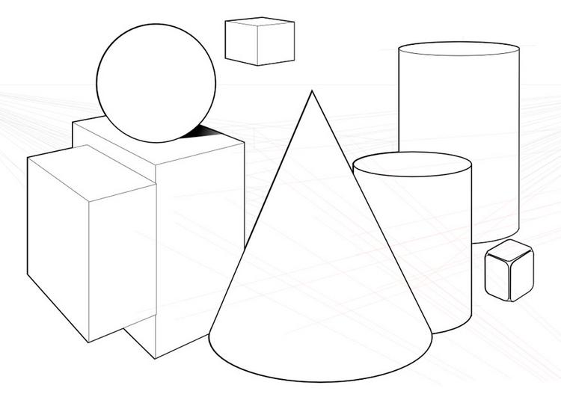
Forms
Forms are three-dimensional shapes expressing length, width, and depth. Balls,
cylinders, boxes, and pyramids are forms.

Slide 5
Space
Space is the area between and around objects.
The space around objects is often called negative space; negative space has shape.
Space can also refer to the feeling of depth.
Real space is three-dimensional; in visual art, when we create the feeling or illusion of depth, we call it space.

Slide 6
Texture
Texture is the surface quality that can be seen and felt. Textures can be rough or
smooth, soft or hard. Textures do not always feel the way they look; for example,
a drawing of a porcupine may look prickly, but if you touch the drawing, the
paper is still smooth.

Slide 7
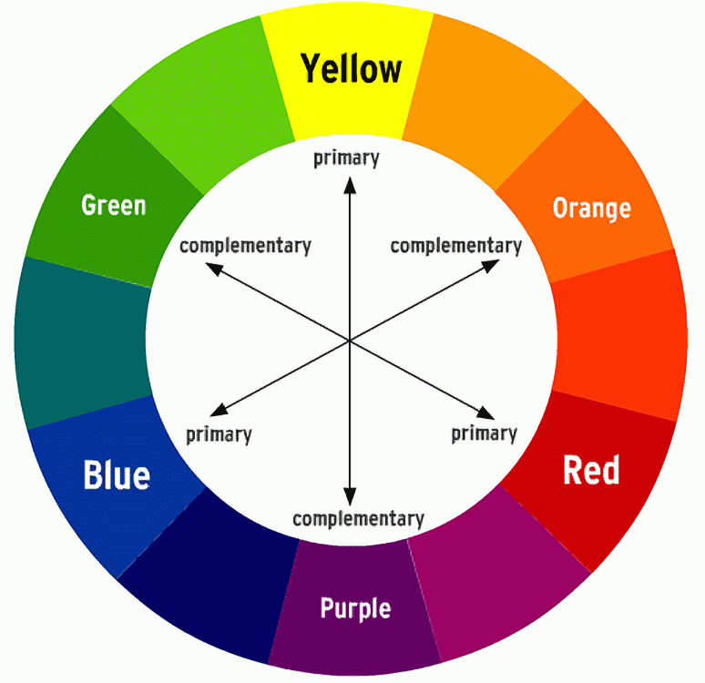
Color
Color is light reflected off of objects. Color has three main characteristics: hue
(the name of the color, such as red, green, blue, etc.), value (how light or dark it
is), and intensity (how bright or dull it is).

Slide 8
Principles of Design

Slide 9
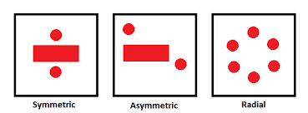
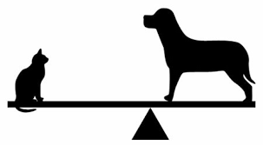
Balance
Balance is the distribution of the visual weight of objects, colors, texture, and space.
If the design was a scale, these elements should be balanced to make a design feel stable.
In symmetrical balance, the elements used on one side of the design are similar to those on the other side; in asymmetrical balance, the sides are different but still look balanced.
In radial balance, the elements are arranged around a central point and may be similar.

Slide 10
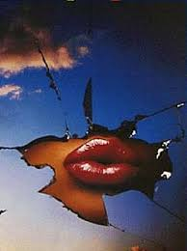
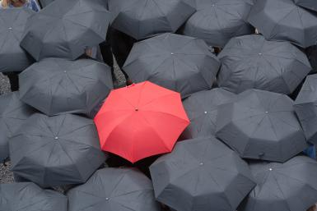
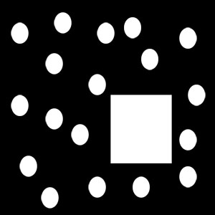
Emphasis
Emphasis is the part of the design that catches the viewer’s attention. Usually the
artist will make one area stand out by contrasting it with other areas. The area could
be different in size, color, texture, shape, etc.

Slide 11
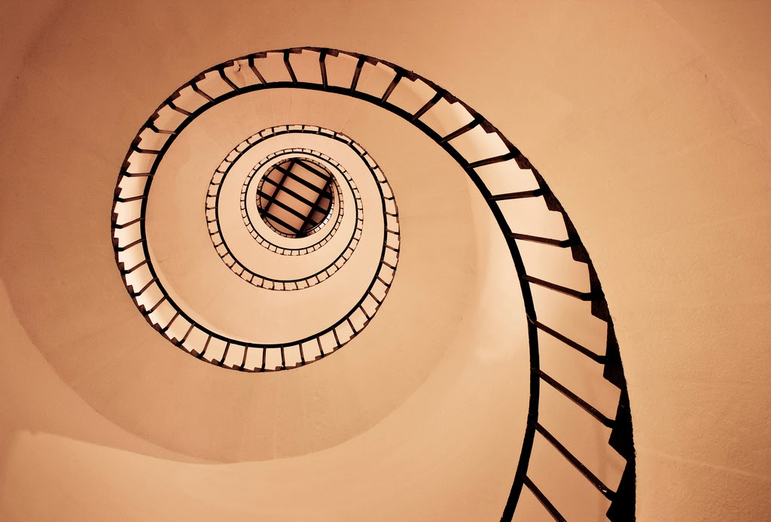
Movement
Movement is the path the viewer’s eye takes through the work of art, often to focal
areas. Such movement can be directed along lines, edges, shape, and color within the
work of art.

Slide 12
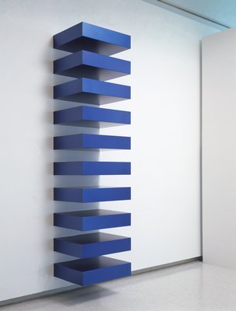
Repetition
Repetition works with pattern to make the work of art seem active. The repetition
of elements of design creates unity within the work of art.
Donald Judd

Slide 13
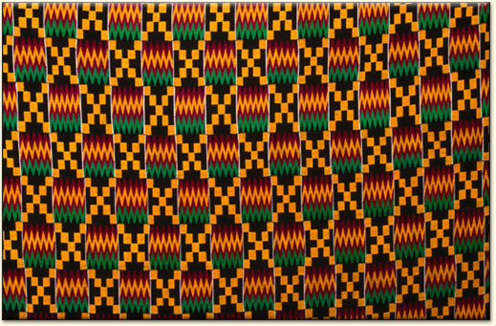
Pattern
Pattern is the repeating of an object or symbol all over the work of art.

Slide 14
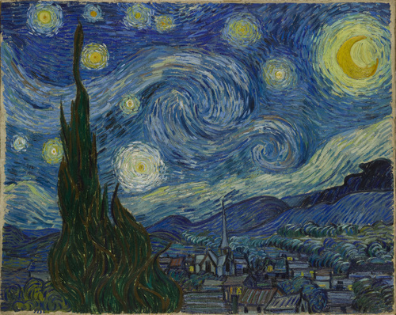
Rhythm
Rhythm is created when one or more elements of design are used repeatedly to create a feeling of organized movement. Rhythm creates a mood like music or dancing. To keep rhythm exciting and active, variety is essential.

Slide 15
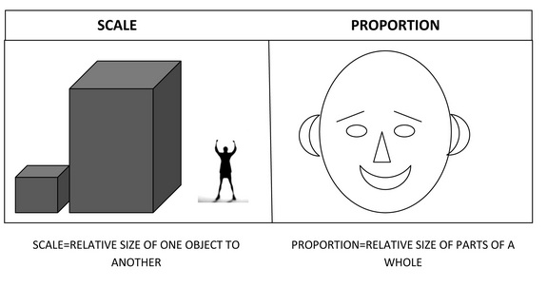
Proportion
Proportion is the feeling of unity created when all parts (sizes, amounts, or number)
relate well with each other. When drawing the human figure, proportion can refer
to the size of the head compared to the rest of the body.

Slide 16
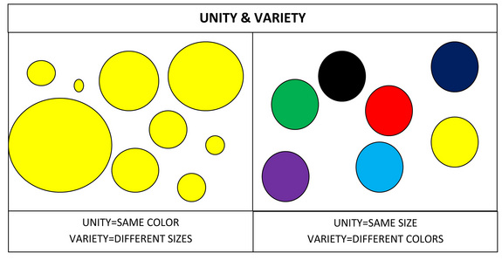
Variety & Unity
Variety is the use of several elements of design to hold the viewer’s attention and to guide the viewer’s eye through and around the work of art.
Unity is the feeling of harmony between all parts of the work of art, which creates a sense of completeness.

