Slide 1
Frank Gehry

Slide 4
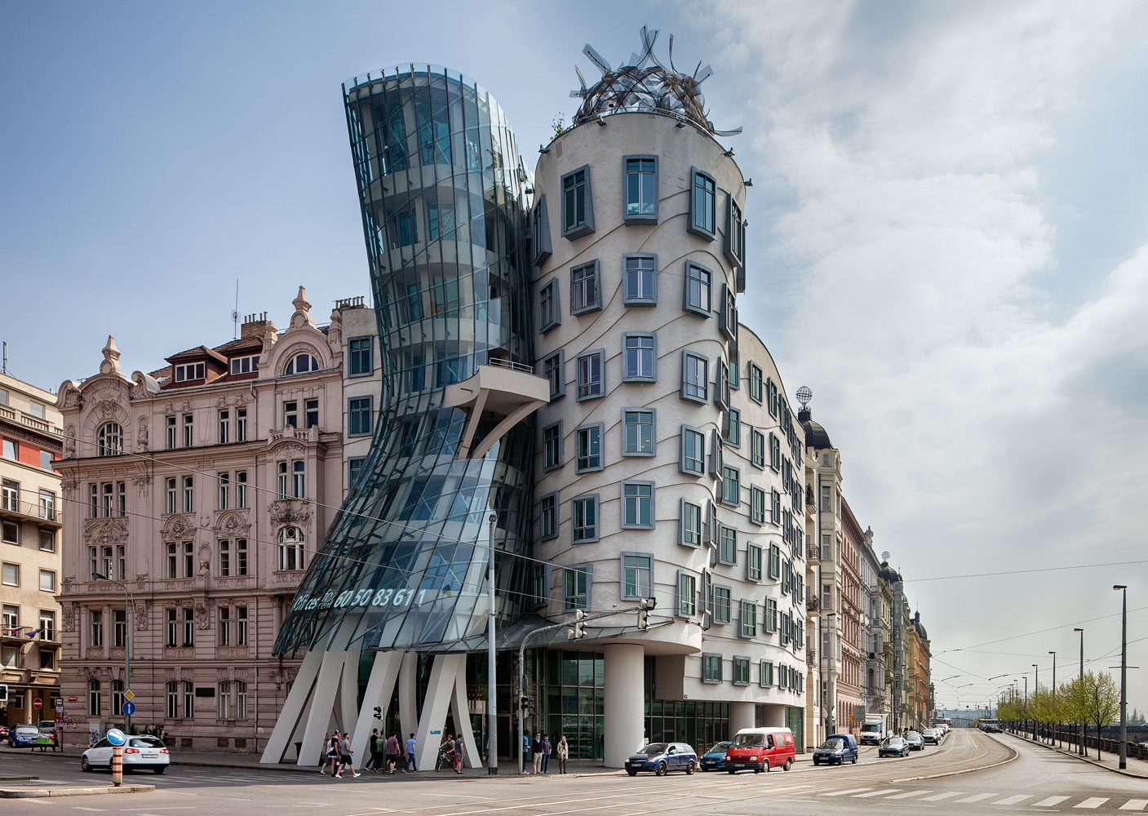

Slide 5
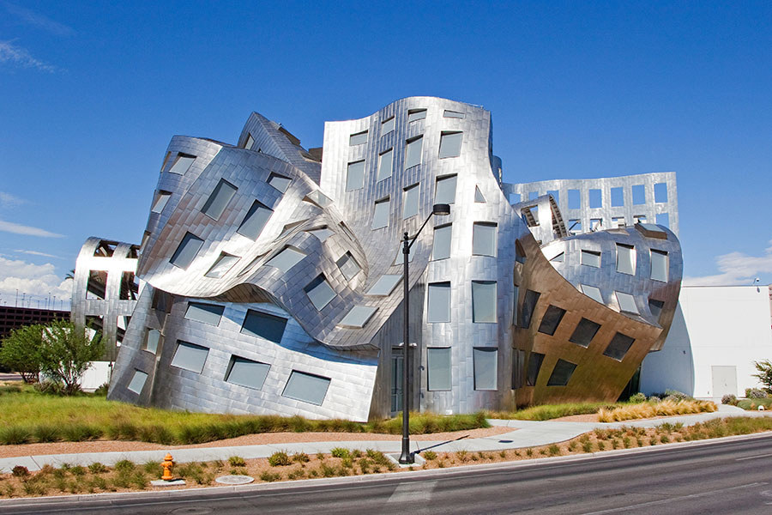

Slide 7
Even cooler images
http://www.architecturaldigest.com/gallery/best-of-frank-gehry-slideshow/all

Slide 8
Time to make our own!

Slide 9
What we will cover.
Risk-taking,
Problem-Solving
Technique (Technical skills)
Visual Movement
Sculpture-in-the-Round, Form
Texture (Actual)
Pattern, Repetition, Line, Abstract
Working with Corrugated Cardboard

Slide 10
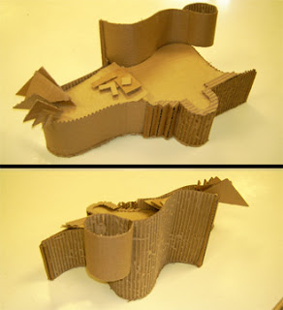

Slide 13
Must Haves
Sculpture-in-the-Round
Visual Movement
Height: At least 15inchs
Positive and Negative Space
Your own design

